Slide 1


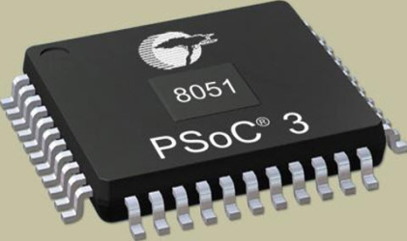
Digital Logic Design
Sanjivani Rural Education Society’s
Sanjivani College of Engineering, Kopargaon-423603
(An Autonomous Institute Affiliated to Savitribai Phule Pune University, Pune)
NAAC ‘A’ Grade Accredited,
Department of Information Technology
(NBA Accredited)
A Y 2024-2025 SEM-I CIA PART B PRESENTAION – I
Presented by | Name 1 (RN-XX) Name 2 (RN-XX) Bbbb Dddd Eeee Dddd Ddddd
Mr. A A Barbind
Guided By

Slide 2

Continuous Internal Assessment Part B Presentation
Problem Statement
Need/Usefulness of Proposed Digital System
Proposed System Description using Black Box View & or Layout
Input & Output Description
Function Table(s) of Proposed System(Truth Table)
Design of Proposed System
Results/Snaps of Simulation
Conclusion
References
Digital Logic Design – CIA PART B Presentation Guided by Mr. A. A. Barbind Department of Information Technology

Slide 3
Problem statement
<Give your problem statement here>
Digital Logic Design – CIA PART B Presentation Guided by Mr. A. A. Barbind Department of Information Technology

Slide 4
Need/Usefulness of Proposed Digital System
<Need/Usefulness>
Digital Logic Design – CIA PART B Presentation Guided by Mr. A. A. Barbind Department of Information Technology

Slide 5
Proposed System Description using Black Box View & or Layout
Digital Logic Design – CIA PART B Presentation Guided by Mr. A. A. Barbind Department of Information Technology

Slide 6
Input & Output Description
<Input1:>
Digital Logic Design – CIA PART B Presentation Guided by Mr. A. A. Barbind Department of Information Technology

Slide 7
Design of Proposed System
<Neat and good visibility diagram>
Digital Logic Design – CIA PART B Presentation Guided by Mr. A. A. Barbind Department of Information Technology

Slide 8
Results/Snaps of Simulation
<Result snaps for various inputs>
Digital Logic Design – CIA PART B Presentation Guided by Mr. A. A. Barbind Department of Information Technology

Slide 9
Conclusion
<Conclusion statements>
Digital Logic Design – CIA PART B Presentation Guided by Mr. A. A. Barbind Department of Information Technology

Slide 10
References to Literature and Tools
<Reference 1>
<Reference 2>
Digital Logic Design – CIA PART B Presentation Guided by Mr. A. A. Barbind Department of Information Technology

